Slide 2

Normative accounts of Probability Weighting in Decision Science
Benjamin Skjold Frederiksen
s182848
Involved researchers & personnel
Ollie Hulme, DRCMR, Supervisor
Tobias Andersen, DTU, Supervisor

Slide 3
Agenda
Background and motivation
Probability weighting – what is it?
Probability weighting – how is it tested?
Probability weighting – why does it exist?
Methods
Experimental design
Model(s)
Simulation study
Results
Future work

Slide 4
Background and motivation Probability Weighting – what is it?
Concept introduced with Prospect Theory (Kahneman and Tversky (1979, 1992))
Non-linear function transforming objective probabilities into people's internal representation of the probability.
Response to examples where expected utility could not explain the general behavior (Allias (1952))

Slide 5
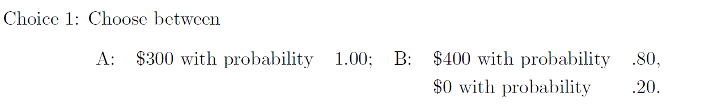
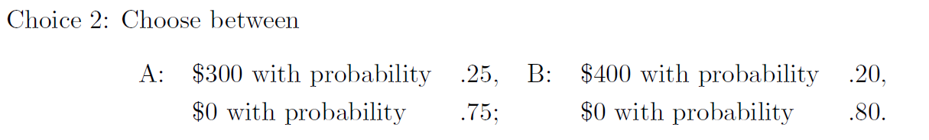
Background and motivation Probability Weighting – what is it?

Slide 6
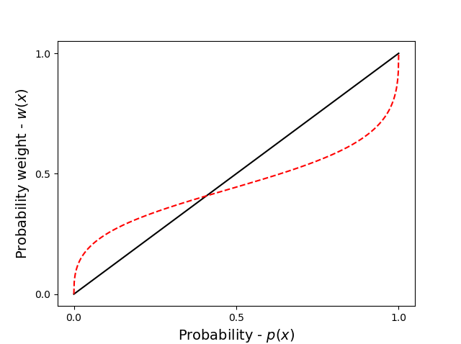
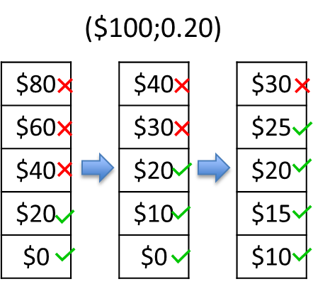

Background and motivation Probability Weighting – How has it been tested?
Decisions from description
Outcome x with probability p
c = 27,5
x = 100
p = 0.2
$$\frac{c}{x}$$
$$p$$

Slide 7
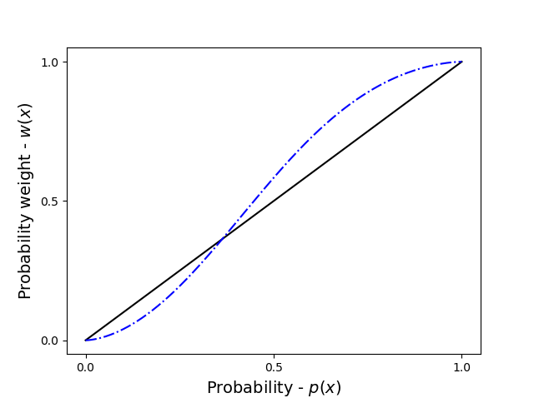
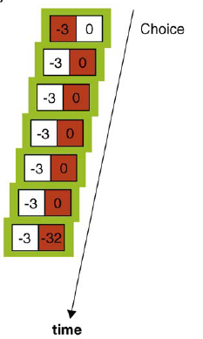
Background and motivation Probability Weighting – How has it been tested?
Decisions from experience
Probabilities and outcomes are not given a priori, but must be learned

Slide 8
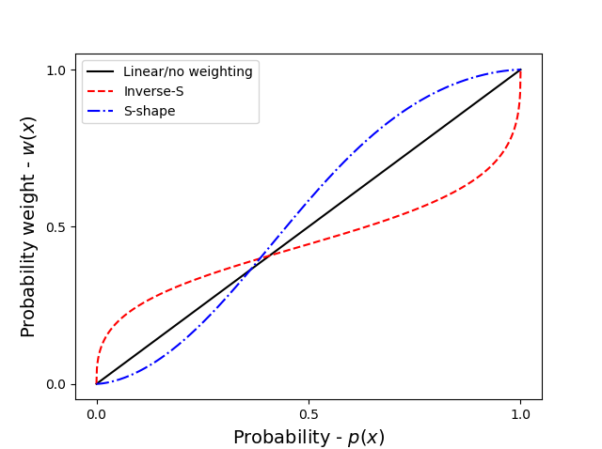
Background and motivation Probability Weighting – what is it?

Slide 9
Background and motivation Probability Weighting – why does it exit?
Descriptive models
Probability weighting is an irrational cognitive bias
Cumulative Prospect Theory (CPT;1992)
Normative models
New theories that seek to provide a normative explanation
Peters et al. (LML;2020)

Slide 10
Thesis objective
2 subquestions:
Does it behave non-linear and if so how?
Does it evolve over time and if so how?

Slide 11
Methods Experimental design

Slide 12
Results Parameter recovery

Slide 13
Future work

